Slide 1
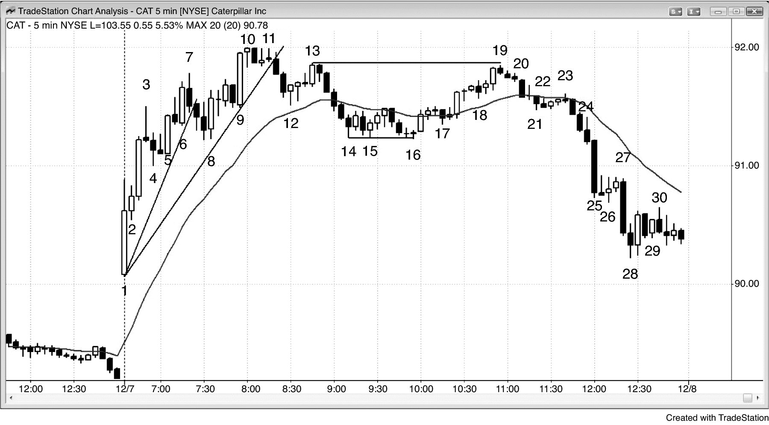
FIGURE 1.1 Trading a Major Reversal

